Slide 1
https://github.com/RemkoPr/Mzumbe-IoT-seminar-2024

Slide 2
Introduction to IoT
ir. Remko Proesmans
AI and Robotics Lab – Ghent University – imec

Slide 3
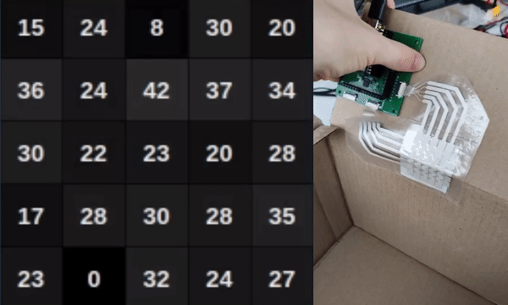
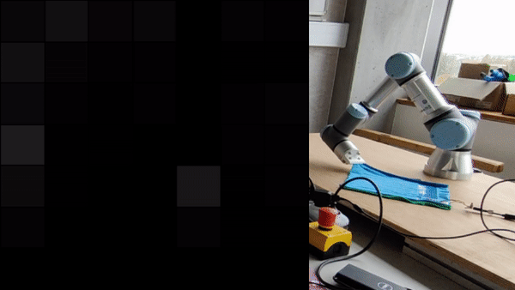
3

Slide 5
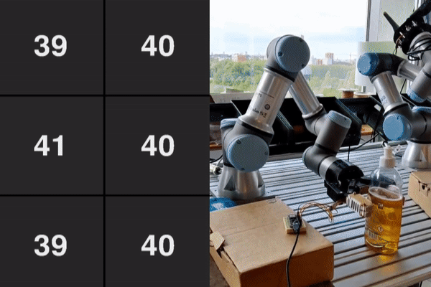
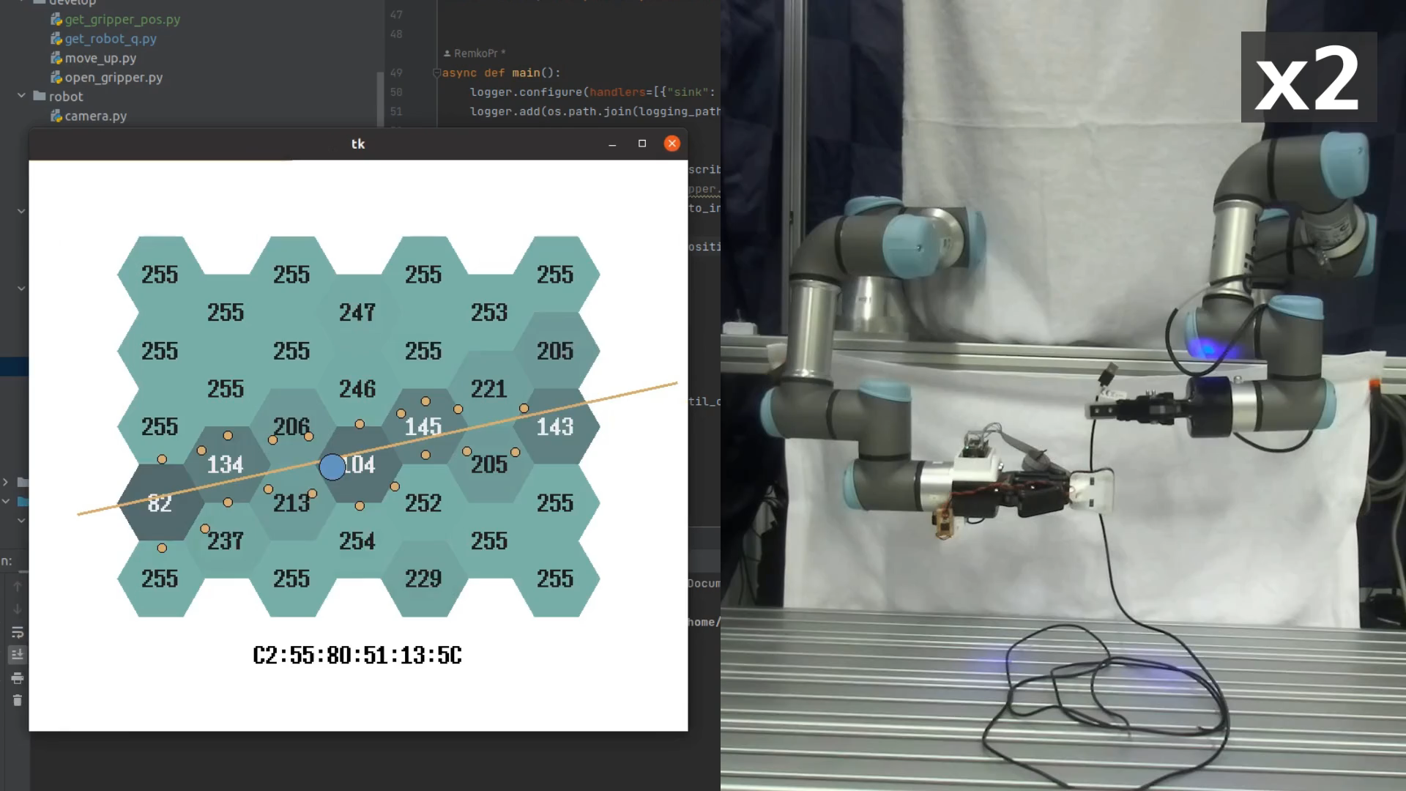
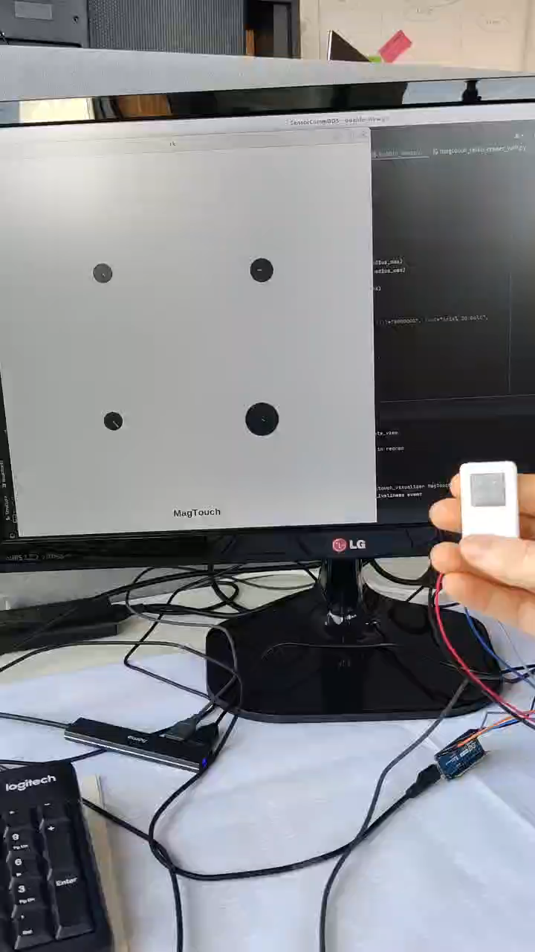
5

Slide 6
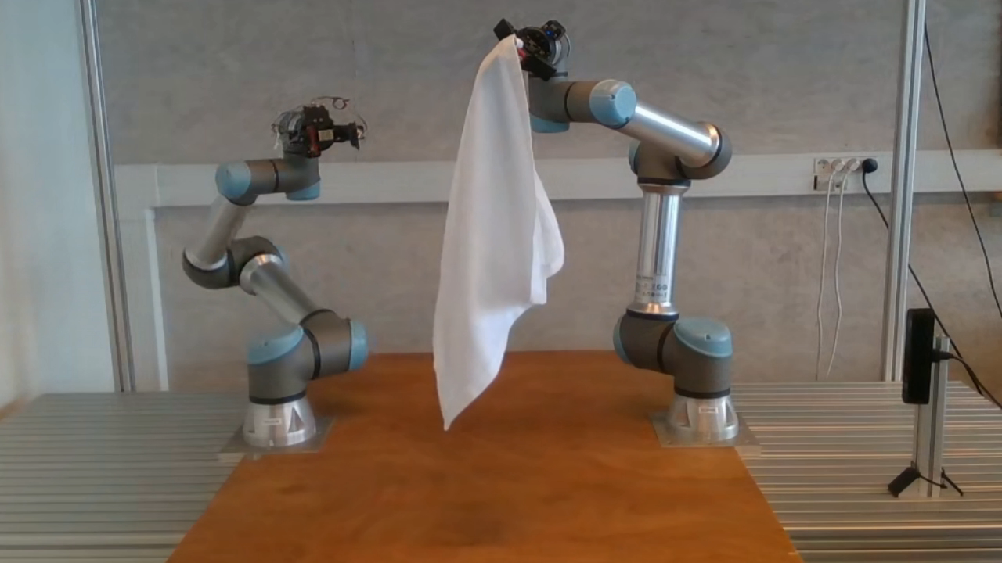

Slide 8





Hardware design
Sensor
firmware
Wireless communication
Data processing & ML
Robotic manipulation
8

Slide 9
Notes:
Ask about backgrounds

Slide 10
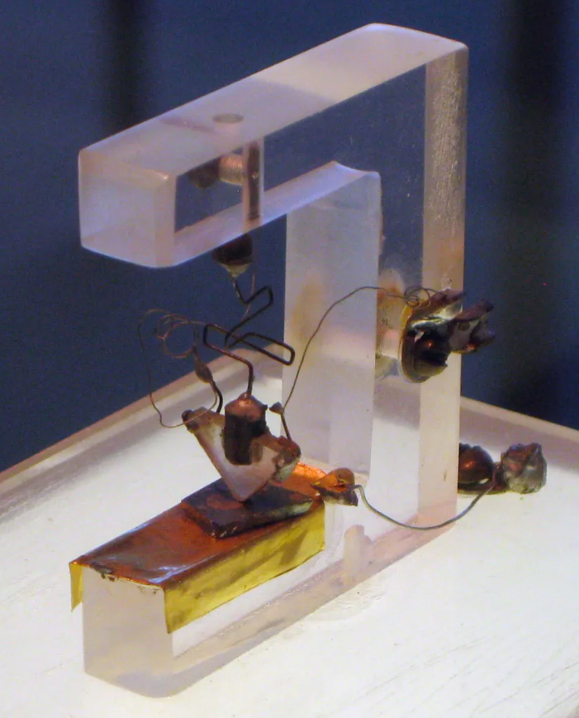
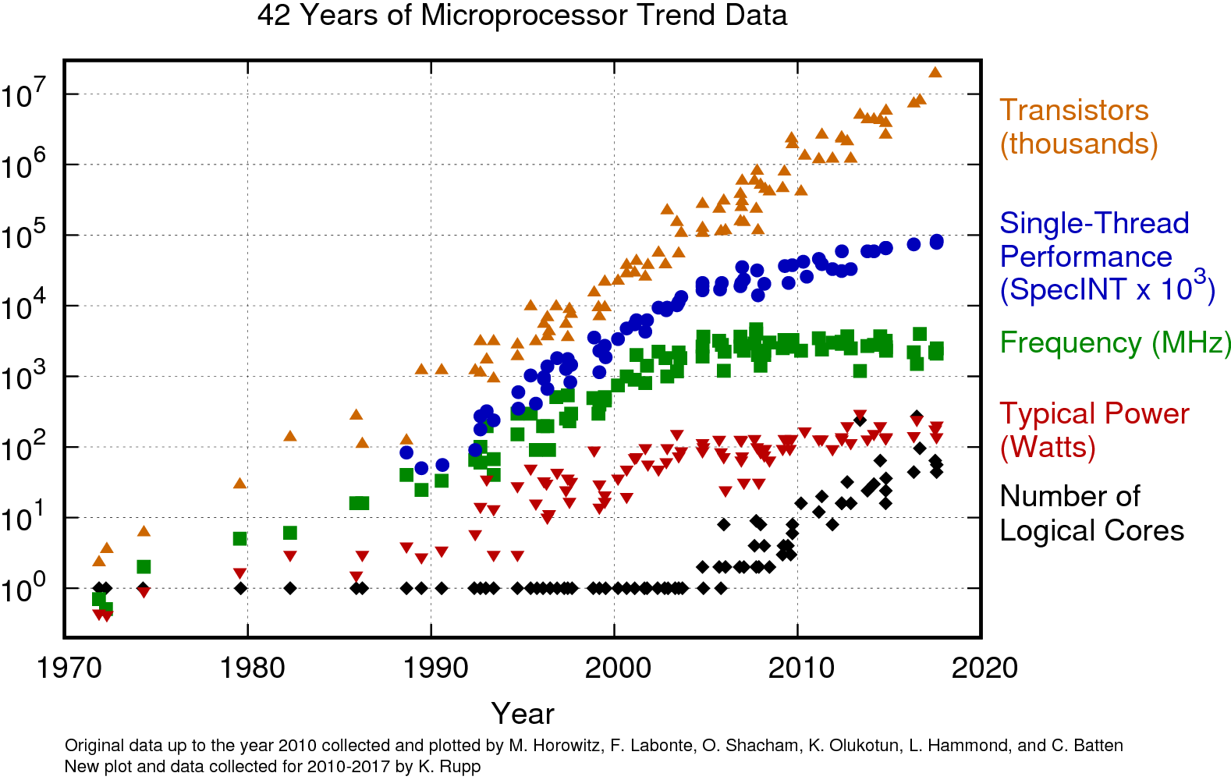
Michael Riordan, “Innovation at Bell Labs”, July 16 2024, Britannica
Karl Rupp, https://github.com/karlrupp/microprocessor-trend-data
10
Notes:
Moore’s law

Slide 11
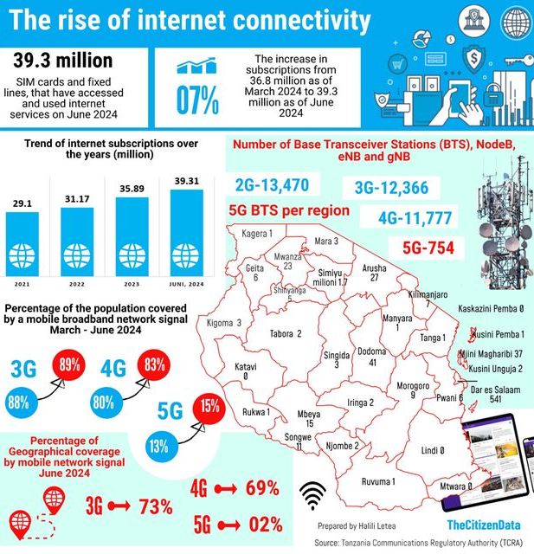
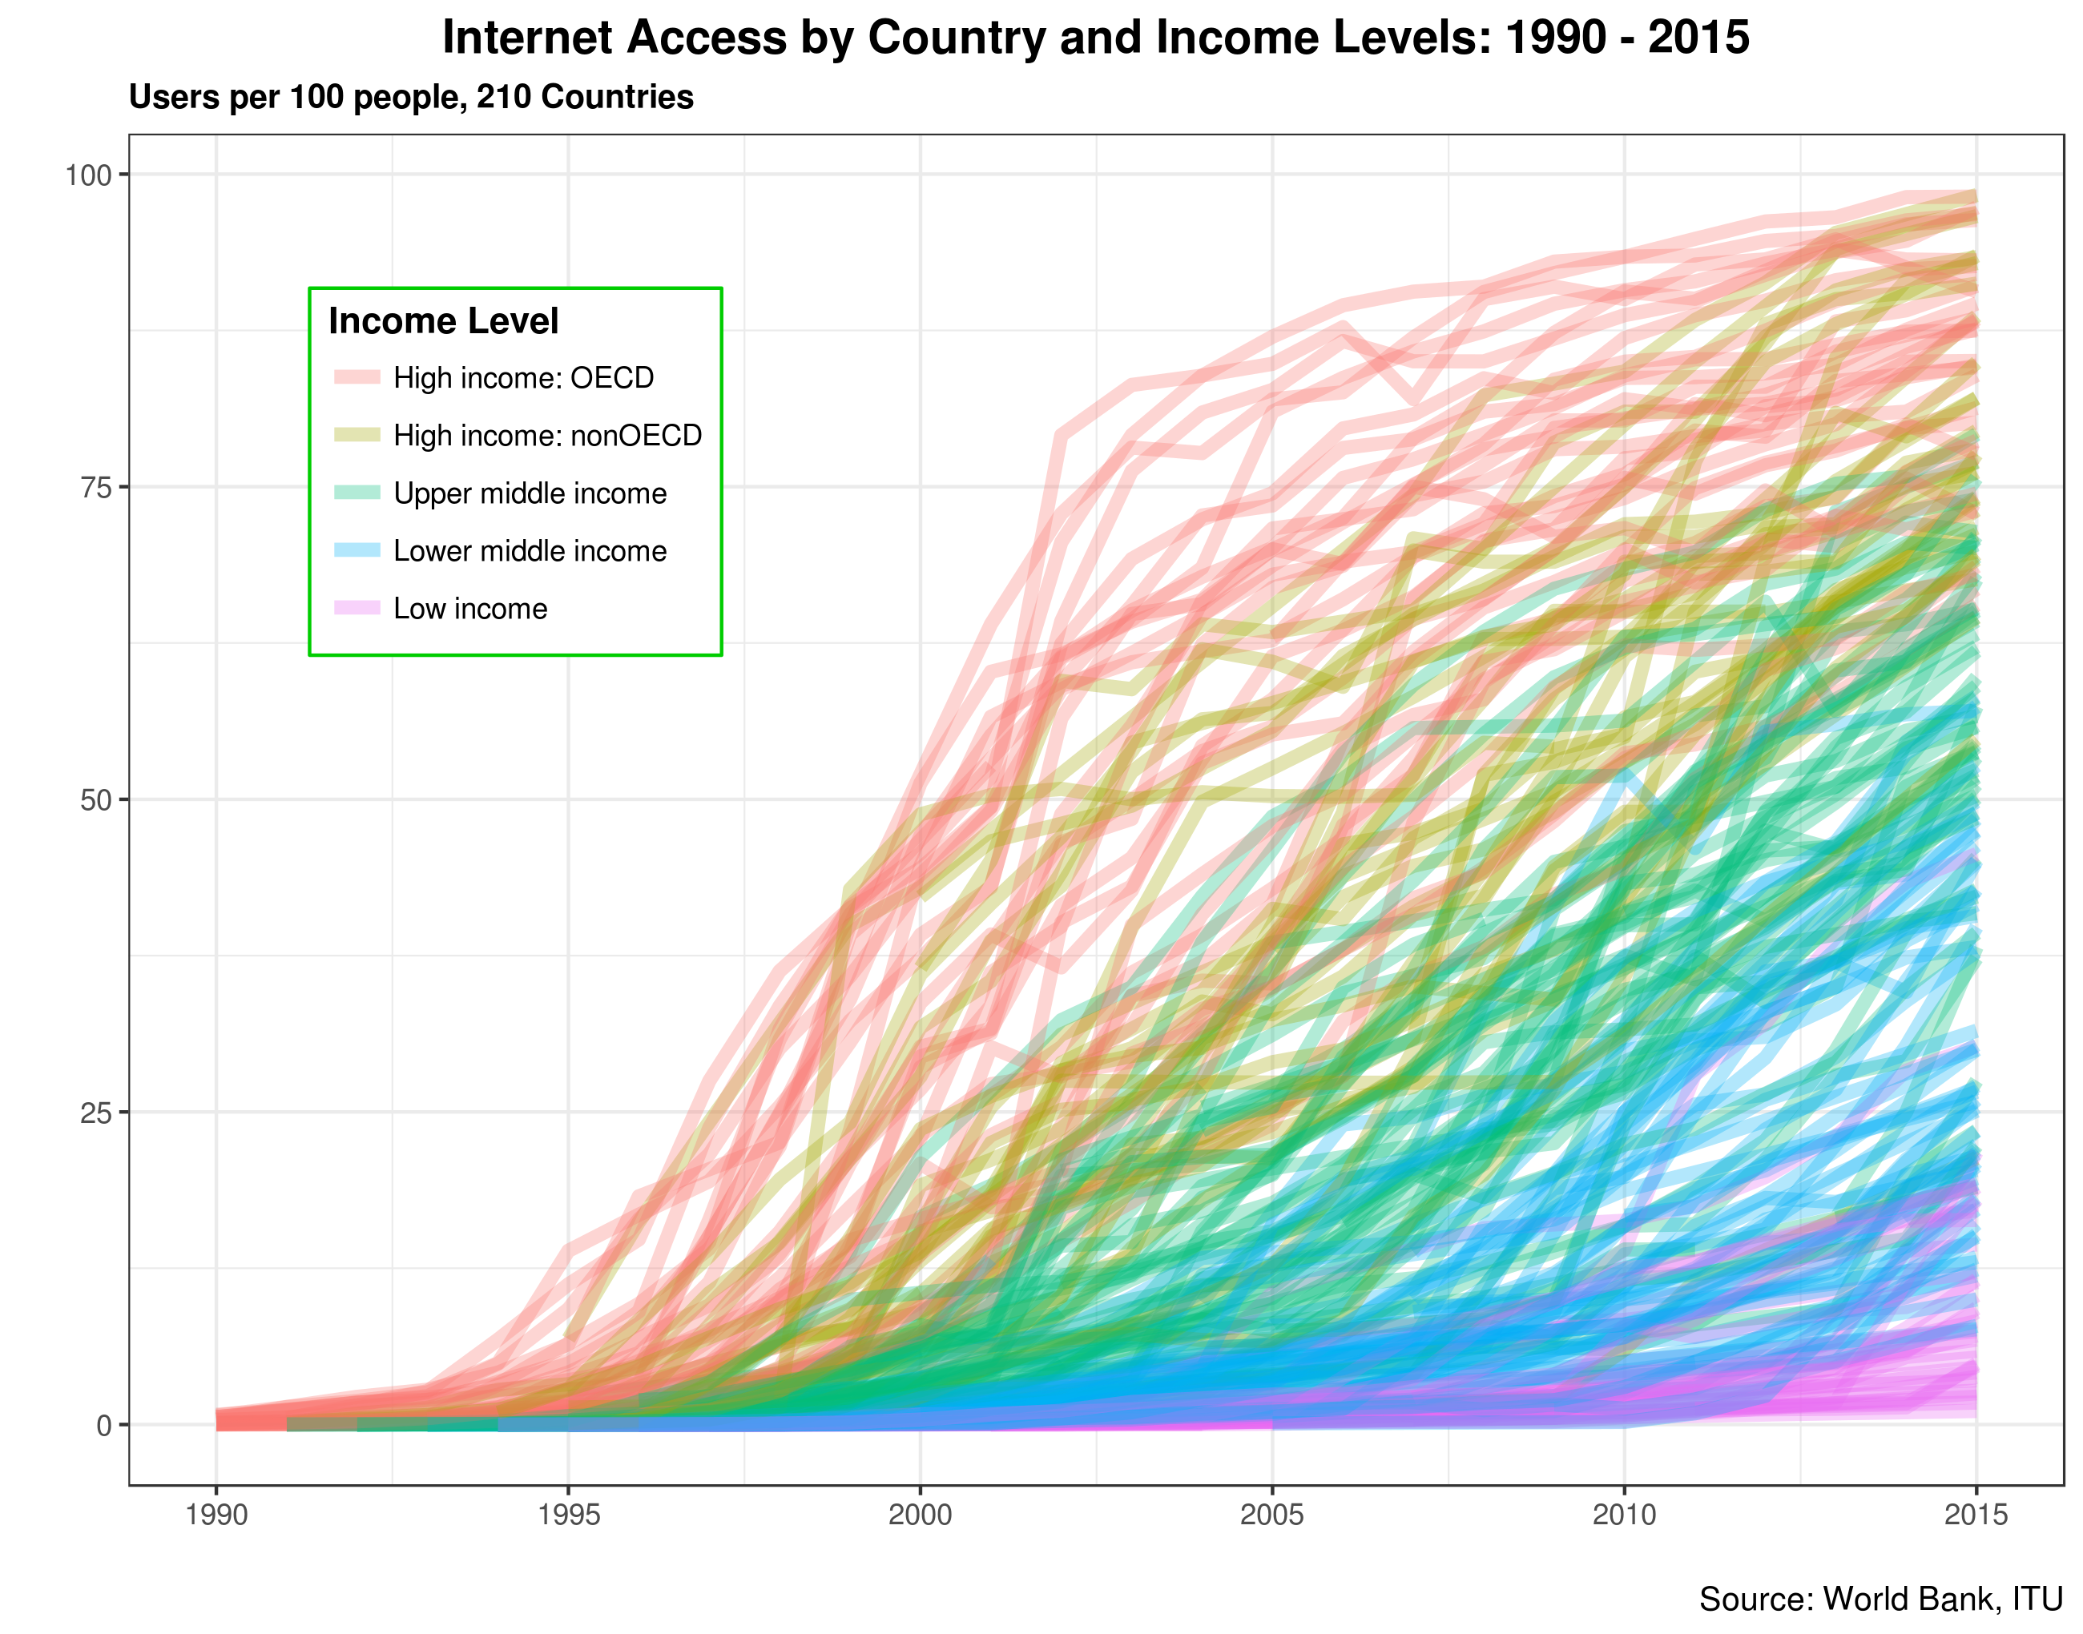
Raúl Zambrano July 2nd, 2017, TechPlus+
11
Notes:
Emphasize economy of scale and lower costs as explanation for widespread adoption

Slide 12
Everyone is connected
EveryTHING is connected
12
Notes:
IOT is the move from «Everyone is connected» to «EveryTHING is connected»

Slide 13
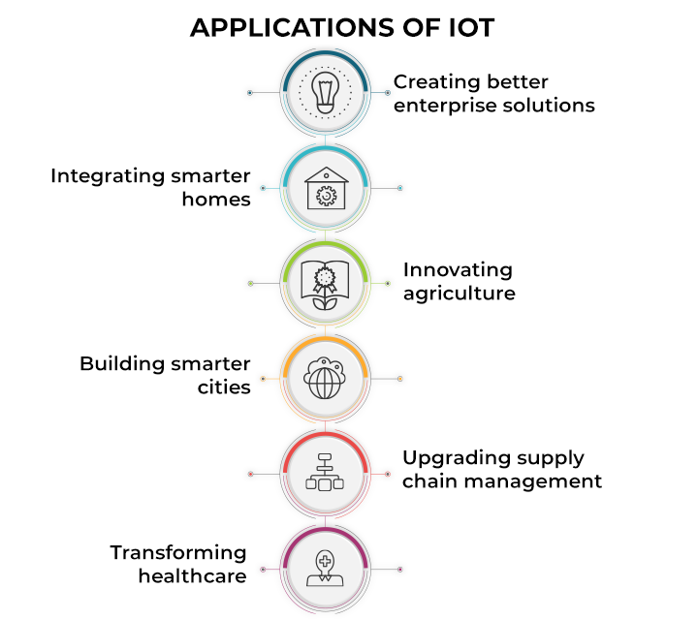
Ramya Mohanakrishnan, Spiceworks.com, May 17, 2022
13

Slide 14
There is no single definition of IOT…
EPoSS (European Technology Platform on Smart Systems Integration) The network formed by things/objects having identities, virtual personalities operating in smart spaces using intelligent interfaces to connect and communicate with the users, social and environmental contexts
US National Intelligence Council The general idea of things, especially everyday objects, that are readable, recognizable, locatable, addressable, and controllable via the Internet - whether via RFID, wireless LAN, wide-area network, or other means
Morgan Stanley The Internet of Things is the combination of sensors, actuators, distributed computing power, wireless communication on the hardware side and applications and big data/analytics on the software side
…
UGent IOT course - Jeroen Hoebeke & Eli De Poorter
14

Slide 15
… but several keywords are prominent
EPoSS (European Technology Platform on Smart Systems Integration) The network formed by things/objects having identities, virtual personalities operating in smart spaces using intelligent interfaces to connect and communicate with the users, social and environmental contexts
US National Intelligence Council The general idea of things, especially everyday objects, that are readable, recognizable, locatable, addressable, and controllable via the internet - whether via RFID, wireless LAN, wide-area network, or other means
Morgan Stanley The Internet of Things is the combination of sensors, actuators, distributed computing power, wireless communication on the hardware side and applications and big data/analytics on the software side
…
UGent IOT course - Jeroen Hoebeke & Eli De Poorter
15

Slide 16
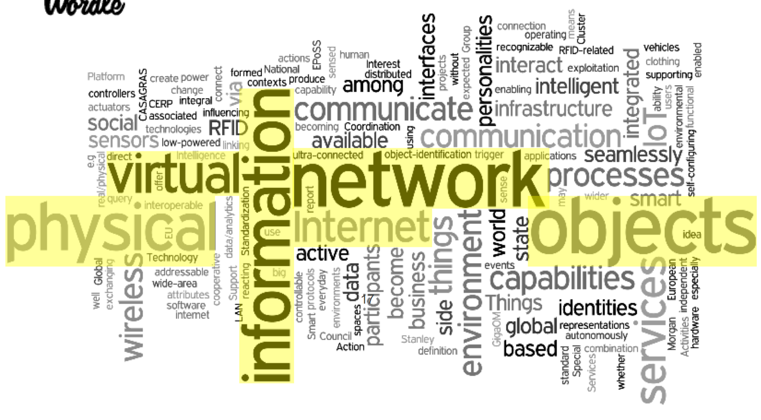
… but many keywords are recurrent
UGent IOT course - Jeroen Hoebeke & Eli De Poorter
16

Slide 17




IoT
Cloud server
Physical world
Network
Sensors
Services/applications
Actuators
MANY DISTRIBUTED, INTERCONNECTED, AUTONOMOUS, LOW-POWER DEVICES
17
Notes:
Difference local-global network

Slide 18

IoT for agriculture
Cloud server
Farmland
Network
Moisturesensor
Services/applications
Irrigation
system
MANY INTERCONNECTED, AUTONOMOUS, DISTRIBUTED, LOW-POWER DEVICES
18
Notes:
Today, we will first be talking about the "internet", the networking, and then about the "things", sensors and actuators

Slide 19
INTERNET
of
THINGS
Notes:
I will be touching on a lot of different concepts, I understand we have a very diverse audience so if some of the details are lost on you, just try to get a general grasp of the concepts I'm talking about. The goal here is that, if you're confronted with one of these concepts, you can come back to this presentation and at least have some structure and some keywords to do your own learning.

Slide 20
INTERNET

Slide 21
INTERNET
Signals
Protocols
Protocols

Slide 22
INTERNET
Signals

Slide 23
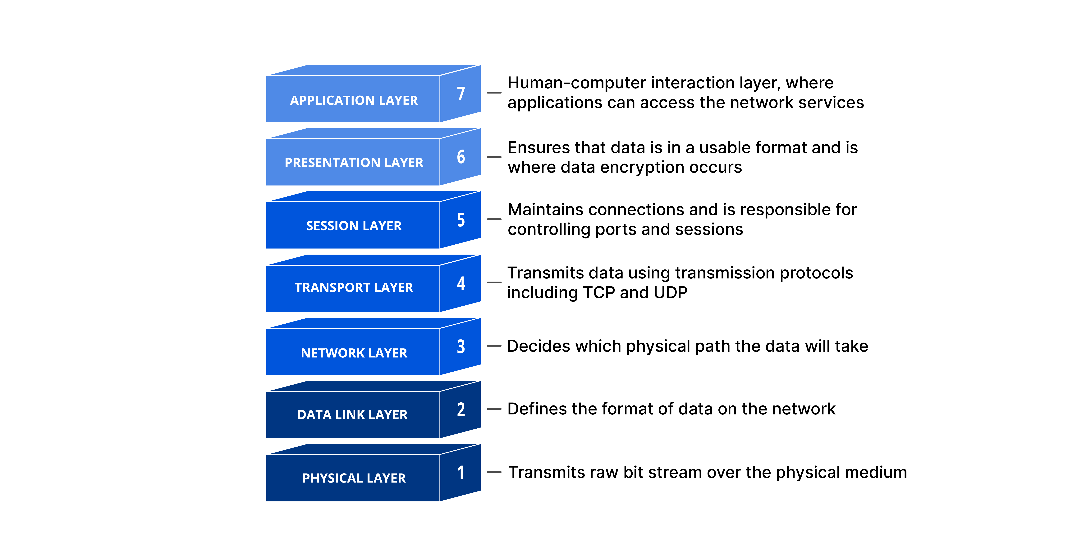
The Open Systems Interconnection (OSI) model describes digital communication
Send data
Receive data
Cloudflare
23
Notes:
Our structure for this part of the presentation will be the OSI model

Slide 24


Well-known protocols cover multiple layers of the OSI stack
Larger networks, lower data rate than BLE
Cloudflare
Notes:
The divide between the layers is also not always very clear, but it can be useful to think in this structure, so we'll cover some important protocols and algorithms

Slide 25
Cloudflare
Notes:
This is the only layer that directly interacts with data from the user. Software applications like web browsers and email clients rely on the application layer to initiate communications. But it should be made clear that client software applications are not part of the application layer; rather the application layer is responsible for the protocols and data manipulation that the software relies on to present meaningful data to the user.

Slide 26


Client-server: HTTP
(Hypertext Transfer Protocol)
Client
Server
HTTP request
Handle request
HTTP response
26
Notes:
Http = Hypertext Transfer Protocol , i.e. it transfers hypertext (texts on computer display interconnected by hyperlinks)
STATELESS: the server doesn't remember previous requests, it just responds to the current request

Slide 27
Client-server: HTTP
(Hypertext Transfer Protocol)
GET /images/dog.jpg HTTP/1.1
Host: www.example.com
...
Client
www.example.com
Retrieve img/dog.jpg
HTTP/1.1 200 OK
…
Content-Type: image/jpg Content-Length: 45321
<binary data of dog.jpg>
27
Notes:
Http = Hypertext Transfer Protocol , i.e. it transfers hypertext (texts on computer display interconnected by hyperlinks)
STATELESS: the server doesn't remember previous requests, it just responds to the current request

Slide 28
Client-server: CoAP
(Constrained Application Protocol)
Client
Server
Request
Handle request
Response
28
Notes:
The aim of this protocol is to also support the REST paradigm in constrained networks, to extend web technology down to the unique requirements for small, constrained embedded devices on low-power, low-bandwidth networks

Slide 29

Client-server: CoAP
(Constrained Application Protocol)
Message Type: Confirmable (CON)
Message ID: 0x7d38
Method: GET
URI: coap://sensor.local/temperature
...
Client
IoT device
Read temperature
Message Type: Acknowledgment (ACK)
Message ID: 0x7d38
...
Content-Format: text/plain
Payload: 22.5°C
29
Notes:
The aim of this protocol is to also support the REST paradigm in constrained networks, to extend web technology down to the unique requirements for small, constrained embedded devices on low-power, low-bandwidth networks

Slide 30
HTTP | CoAP
Stateless
Strict client-server model | Client-server, but also supports multicast
Large headers | Smaller headers
Wide range of content types | Basic content types
Human-readable, text-based format | Binary format
Uses TCP | Uses UDP
30

Slide 31

Publisher-subscriber: MQTT and DDS
Subscribe
to topic 2
Subscribe
to topic 1
Publish
to topic 1
Broker
Publish
to topic 2
31
Notes:
The publish/subscribe or pub/sub pattern paradigm is an alternative to the traditional client-server model, where a client communicates directly with an endpoint. Pub/Sub decouples a client, who is sending a particular message - called a publisher - from other clients that are receiving the message -called subscribers. This means that the publisher and subscriber do not know about the existence of one another. This requires a third component, called broker, which is known by both the publisher and subscriber. ASYNCHRONOUS, pub/sub can work independently of each other’s timing, sub can receive messages even if pub is off.
I personally use DDS for my sensor systems

Slide 32
Cloudflare

Slide 33
INTERNET
Protocols

Slide 34

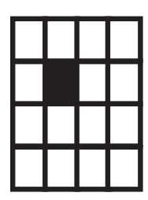




Team 1
PROTOCOL GAME
Team 2
Team 3
34
Notes:
Draw enough black squares

Slide 35
Rules
You have 15 minutes to come up with your protocol
Only one natural number smaller than 300 can be communicated at a time. A natural number is a non-negative number with no digits after the comma: 0, 1, 2, 3, 4, ...
A number is communicated by one person running from Computer to Printer, no talking between Computer and Printer
PROTOCOL GAME
35
Notes:
40min
End: we've thought about REPRESENTATIONS/COMPRESSIONS, their EFFICIENCY
Try to transmit full black or full white with your protocols

Slide 38
Cloudflare
Notes:
ENCODING, COMPRESSION, ENCRYPTION

Slide 39
RSA encryption
We can easily find three very large positive integers e, d, and n, such that for all integers m (0 ≤ m < n), both (m^{e})^{d} and m have the same remainder when divided by n.
However, when given only e and n, it is extremely difficult to find d: d is derived from the prime factors of n, and factoring large numbers takes lots of calculations.
e and n:
d:
m:
m^{e} mod n = c:
public key
private key
message
encrypted message
c
m
A
B
m = c^{d} mod n
39
Notes:
To be fair: RSA has some computational overhead so it may not be suitable for simple IoT devices, alternatives exist, e.g. Elliptic Curve Cryptography

Slide 40
RSA security is based on the encryption being EXTREMELY HARD to crack, but NOT IMPOSSIBLE to crack.
Brute forcing RSA requires FACTORING OF LARGE NUMBERS, which TAKES A LOT OF CALCULATIONS in traditional computing.
40
Notes:
To be fair: RSA has some computational overhead so it may not be suitable for simple IoT devices, alternatives exist, e.g. Elliptic Curve Cryptography

Slide 41
RSA security is based on the encryption being EXTREMELY HARD to crack, but NOT IMPOSSIBLE to crack.
Brute forcing RSA requires FACTORING OF LARGE NUMBERS, which TAKES A LOT OF CALCULATIONS in traditional computing.
Quantum computing
41
Notes:
To be fair: RSA has some computational overhead so it may not be suitable for simple IoT devices, alternatives exist, e.g. Elliptic Curve Cryptography

Slide 42
RSA security is based on the encryption being EXTREMELY HARD to crack, but NOT IMPOSSIBLE to crack.
Brute forcing RSA requires FACTORING OF LARGE NUMBERS, which TAKES A LOT OF CALCULATIONS in traditional computing.
Quantum computing WILL NOT MAKE EVERY CALCULATION FASTER, but it will allow for MUCH FASTER FACTORING OF NUMBERS, and hence IT COULD BREAK RSA.
42
Notes:
To be fair: RSA has some computational overhead so it may not be suitable for simple IoT devices, alternatives exist, e.g. Elliptic Curve Cryptography (still quantum vulnerable)

Slide 43
Cloudflare
Notes:
This is the layer responsible for opening and closing communication between the two devices. The time between when the communication is opened and closed is known as the session. The session layer ensures that the session stays open long enough to transfer all the data being exchanged, and then promptly closes the session in order to avoid wasting resources.

Slide 44
x
Cloudflare
Notes:
This is the only layer that directly interacts with data from the user. Software applications like web browsers and email clients rely on the application layer to initiate communications. But it should be made clear that client software applications are not part of the application layer; rather the application layer is responsible for the protocols and data manipulation that the software relies on to present meaningful data to the user.

Slide 45
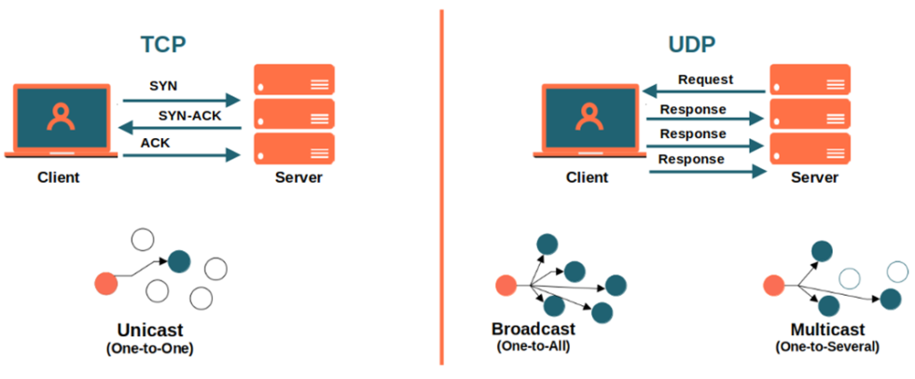
TCP vs UDP
Let's Decode, Medium.com
45
Notes:
Couple back to HTTP vs CoAP

Slide 46
?
x
Cloudflare

Slide 47
Internet Protocol (IP)
IPv4: 192.168.52.2
→ 32 bits → 4.3⋅10⁹ addresses
IPv6: FE80:CD00:0000:0CDE:1257:0000:211E:729C
→ 128 bits → 3.4⋅10³⁸ addresses
47
Notes:
Number of IPv4 addresses is only half as many as people in the world
Diameter observable universe is <10^27m

Slide 48
https://www.youtube.com/watch?v=0fKBhvDjuy0&start=30
48
Notes:
Number of IPv4 addresses is only half as many as people in the world
Diameter observable universe is <10^27m

Slide 49


Internet Protocol (IP)
Local network
Internet
192.168.52.2
192.168.52.3
192.168.52.1
145,12,131,7
192.168.52.4
49
Notes:
If the destination is within the same network, the packet is sent directly.
If not, each router has a table that maps IP address ranges to the next hop (another router or network).

Slide 50
Internet Protocol (IP)
Local network
Internet
192.168.52.2
192.168.52.3
192.168.52.1
145,12,131,7
Routing table
192.168.52.4
50
Notes:
If the destination is within the same network, the packet is sent directly.
If not, each router has a table that maps IP address ranges to the next hop (another router or network).

Slide 51
The routing table can be updated dynamically
Distance-Vector Protocol: Uses hop count as a metric to determine the best path (up to a maximum of 15 hops)
OSPF (Open Shortest Path First): Builds a map of (part of) the network and uses Dijkstra’s algorithm to calculate the shortest path to each node.
…
51
Notes:
Static also possible, simply user configured

Slide 52
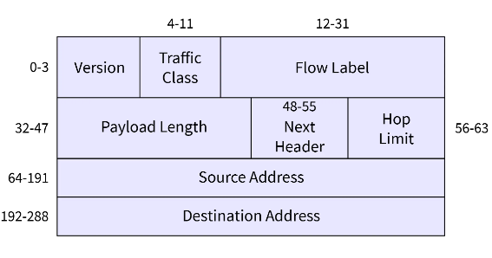
6LoWPAN adapts IPv6 for constrained devices
Header compression
Fragmentation: IPv6 has MTU of >1280 bytes, IPv6 packets are fragmented into multiple link-level frames
Layer-two routing: avoid network layer overhead
52
Notes:
6LoWPAN Low-Power Wireless Personal Area Network
The IPv6 version field is always set to 6. It can be entirely omitted in compressed form.
Traffic Class and Flow Label: If these fields are not used or set to default values, they can be compressed or omitted.
Hop Limit: Common values (like 1 or 64) are represented with just a couple of bits. For example, if the hop limit is 64, it can be represented in 2 bits instead of 8.
Source and Destination Addresses: eliding well-known prefixes.
IPv6 has MTU of >1280 bytes, so all links in the network must be able to handle this message length. However, this is likely not the case in constrained IoT networks. IPv6 packets are fragmented into multiple link-level frames

Slide 53
0 | 1 | 0 | 0 | 1 | x | 1 | 0
x
x
Cloudflare
Notes:
MAC addresses. Also bit error correction (with CRC for example)

Slide 54
Parity bit error correction
Transmitted word
Parity bit
0 | 1 | 1 | 0 | 0
0 | 1 | 0 | 0 | 1
1 | 1 | 1 | 0 | 0
0 | 0 | 1 | 0 | 1
Uneven number of 1's:
error occurred
54
Notes:
The parity bit is added to every word such that the amount of 1's is even. So if the word to be sent has e.g. one "1" bit, the parity bit is "1", such that the total number of 1's is two. If the number of 1's is 2, the parity bit is 0 because the number of 1's is already even.

Slide 55
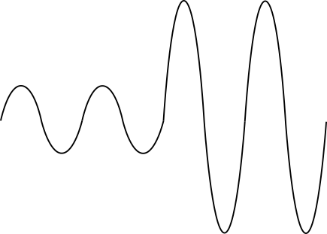
Cloudflare

Slide 56
Wireless communication signals are composed of sine waves
$$A\left(t\right)\sin{(2πf\left(t\right)t}+φ(t))$$
Amplitude
Frequency
Phase
56
Notes:
They are propagating electromagnetic waves

Slide 57
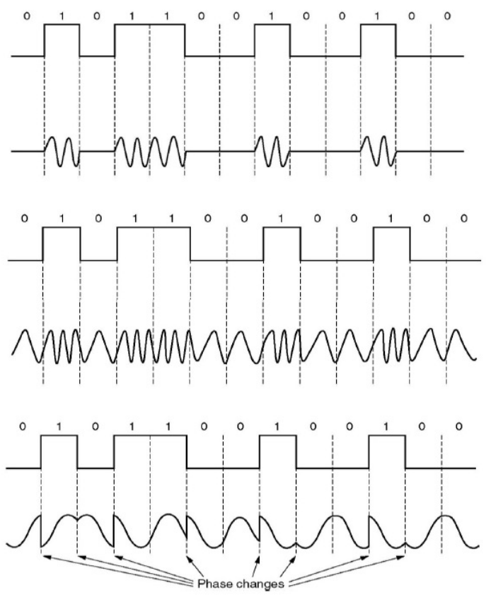



Data is transmitted through wave modulation
Vary A(t): Amplitude shift keying (ASK)
Vary f(t): Frequency shift keying (FSK)
Vary (t): Phase shift keying (PSK)
UGent IOT course - Jeroen Hoebeke & Eli De Poorter
57
Notes:
Bluetooth: FSK

Slide 58
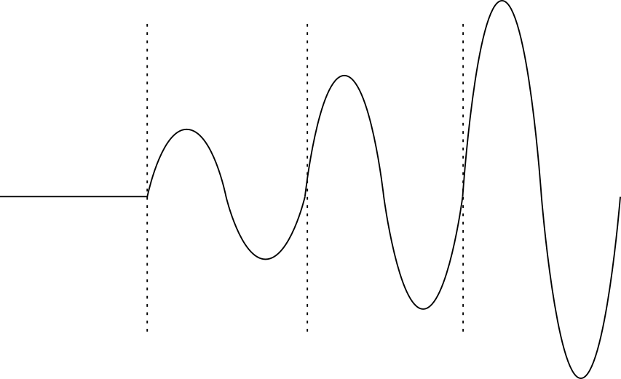
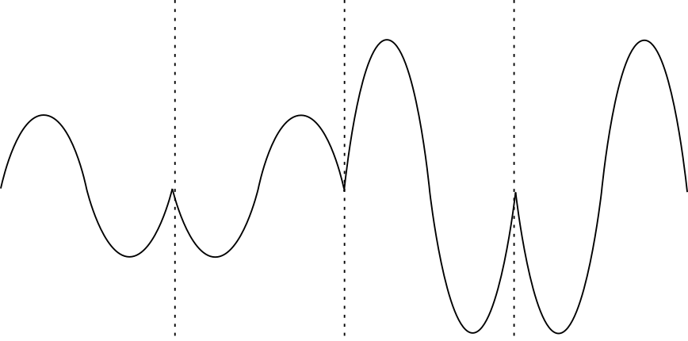
Multiple bits can be transferred per symbol
00
01
10
11
ASK
00
01
10
11
Binary PSK + ASK
58

Slide 59
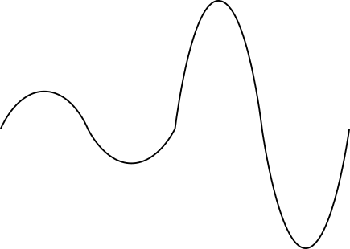
Data rate can be increased through frequency division multiplexing (FDM)
0
1
Channel 1 at carrier f₁
0
1
Channel 2 at carrier f₂
59

Slide 60
Data rate can be increased through code division multiplexing (CDM)
In CDM, data belonging to one channel is made to look like noise to a different channel
60

Slide 61
Multiplexing can also be implemented as Multiple Access
FDM -> FDMA
CDM -> CDMA
Data belonging to one user is made to look like noise to a different user
Data for user 1
at carrier f₁
Data for user 2
at carrier f₂
61

Slide 62
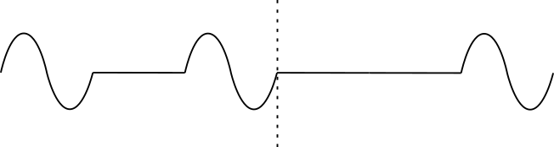
Other Multiple Access techniques
Time Division MA
Space Division MA
Directive antenna
Data for user 1
during interval t₁
Data for user 2
during interval t₂
User 1
User 2
62
Notes:
SDMA also possible through wired connections

Slide 63
Multiple Access
Multiplexing
Cloudflare
Notes:
How many bits in a word? How is a message terminated?

Slide 64
Signals are distorted in different ways
Path loss
64

Slide 65
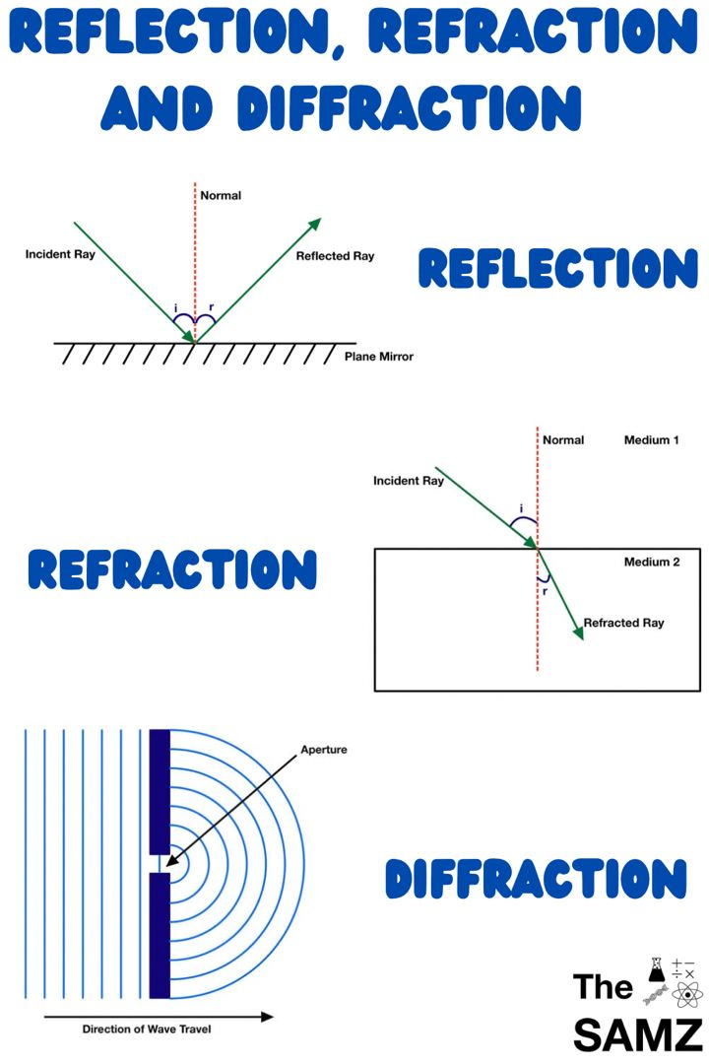
Signals are distorted in different ways
Path loss
Reflection/refraction
Reflection
Refraction
65

Slide 66
Signals are distorted in different ways
Path loss
Reflection/refraction
Diffraction
Diffraction
66

Slide 67
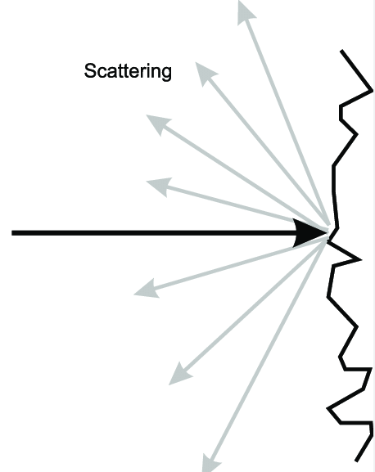
Signals are distorted in different ways
Path loss
Reflection/refraction
Diffraction
Scattering
67

Slide 68
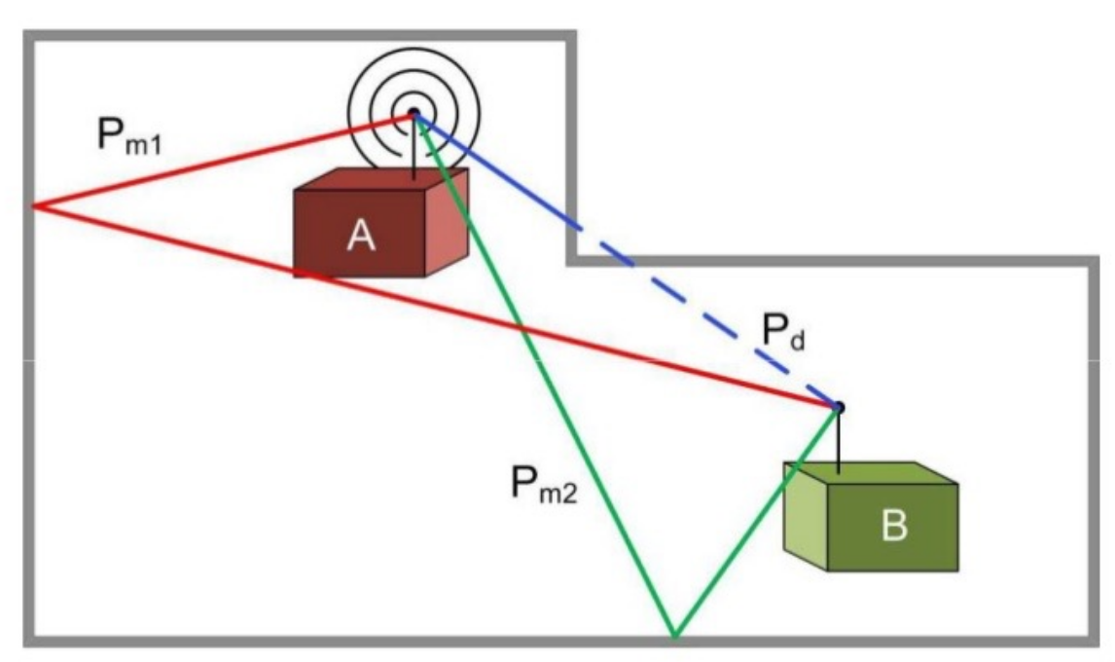
Signals are distorted in different ways
Path loss
Reflection/refraction
Diffraction
Scattering
Multipath fading
UGent IOT course - Jeroen Hoebeke & Eli De Poorter
68
Notes:
Multipath fading relates to interference
Need for error correction etc in higher OSI layers

Slide 69
Practical
Dwengo schema uitleggen
https://blockly.dwengo.org/
https://dwengo.org/physical_computing/
Sensoren beschikbaar: licht/DHT11 temp+rel vochtigheid?/geluid/sonar (rest zelf bestellen)
Dataloggers Olivier vermelden
69

Slide 70

HTTP, CoAP, MQTT, DDS
Protocol game, RSA
x
TCP/UDP
x
?
IP
Parity bit, MA
0 | 1 | 0 | 0 | 1 | x | 1 | 0
x
x
Modulation, Multiplexing
Cloudflare

Slide 71
INTERNET
of
THINGS
Notes:
Questions?

Slide 72
THINGS

Slide 73
THINGS
Power management
Sensors
Actuators

Slide 74
THINGS
Power management

Slide 75
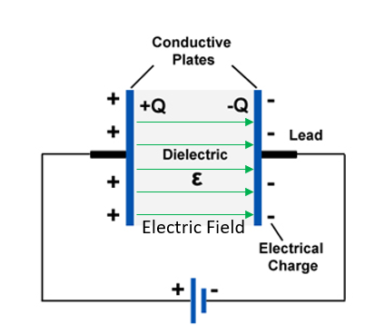
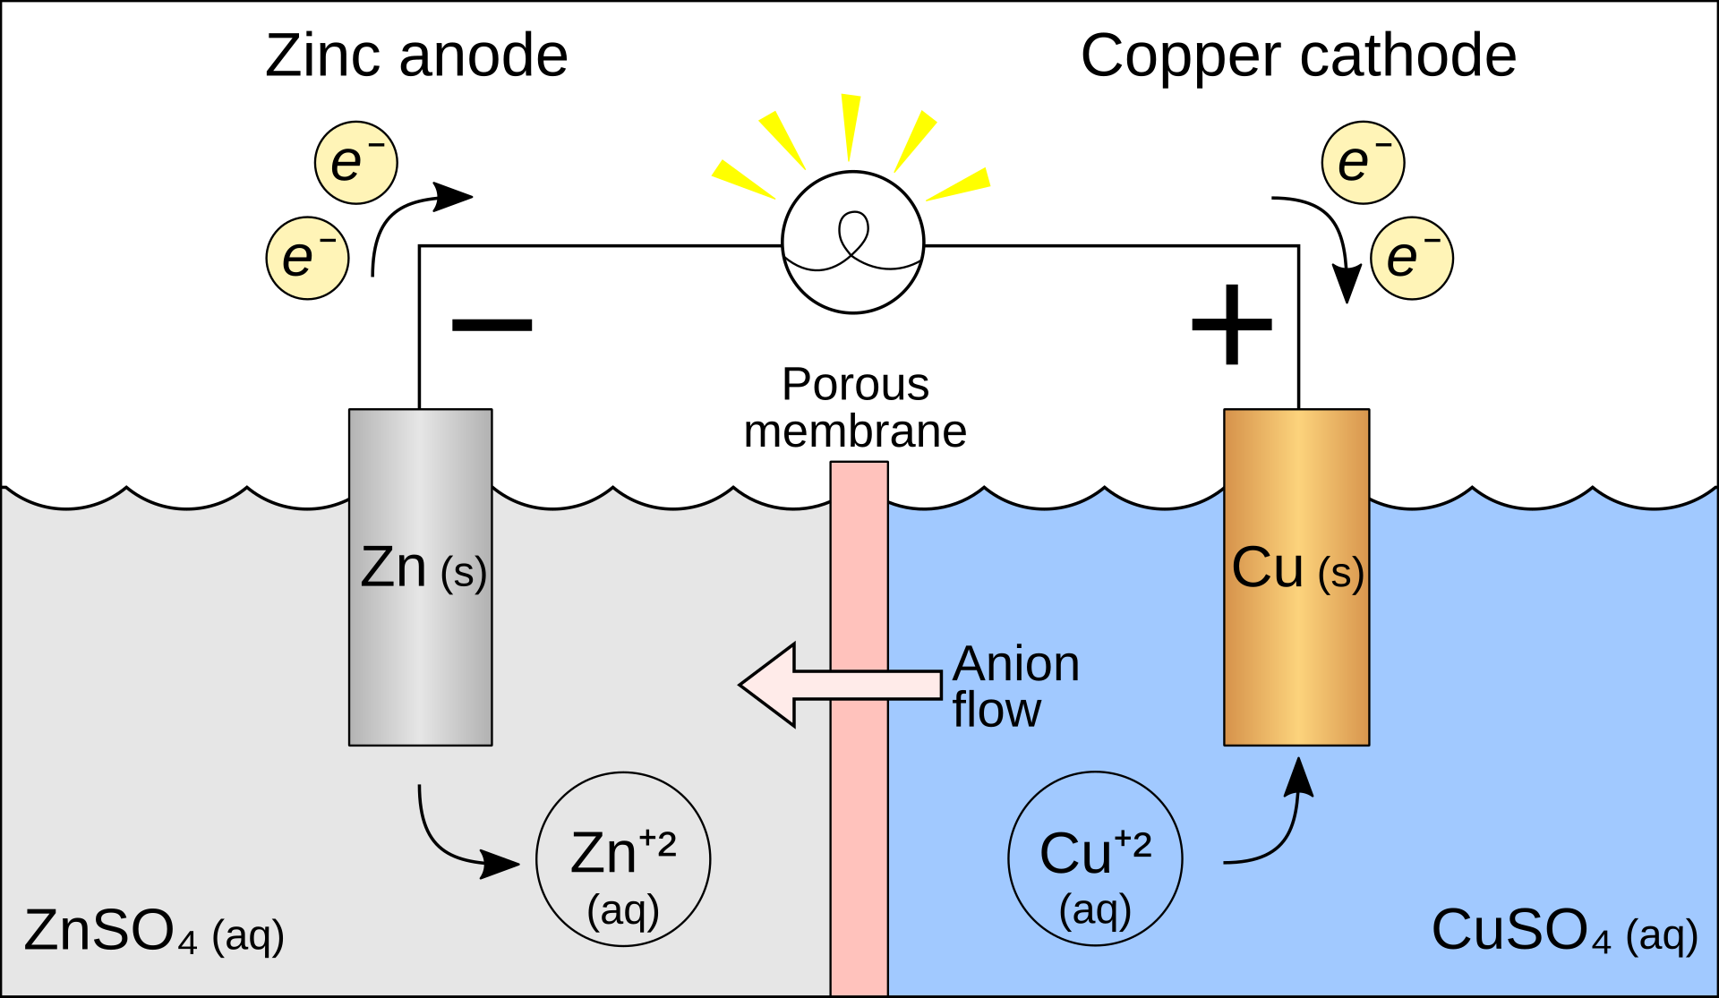
Battery
Capacitor
Stores charge in chemical form
Stores charge in electric field
https://en.wikipedia.org/wiki/Galvanic_cell
https://www.nde-ed.org/Physics/Electricity/capacitance.xhtml
75
Notes:
We won't talk about wired power because it doesn't quite capture the spirit of IoT

Slide 76


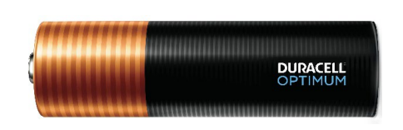
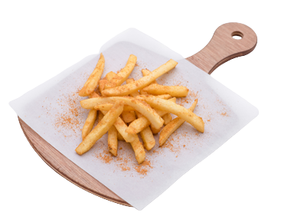
<2kcal
384kcal
Duracell OP1500 AA battery
(230g)
76

Slide 77
Battery technology lags behind
Slow increase of capacity: ~8% yearly increase (Wh/cm3)
Duracell OP1500 AA battery
77

Slide 78
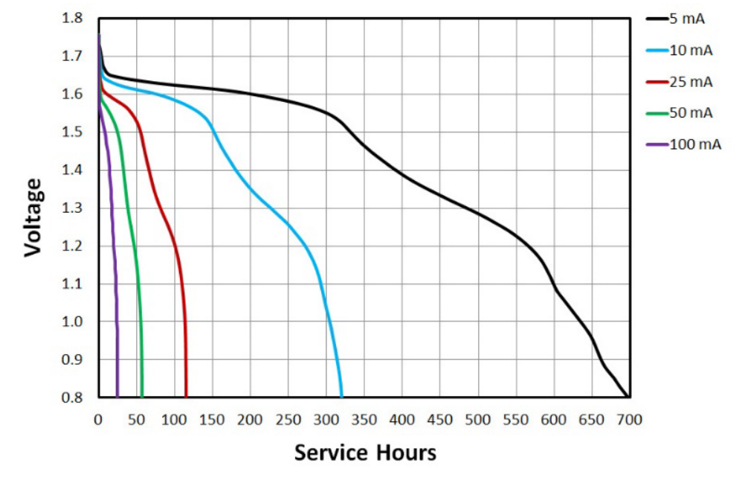
Batteries do not output constant voltage over prolonged use
Duracell OP1500 AA battery
78

Slide 79
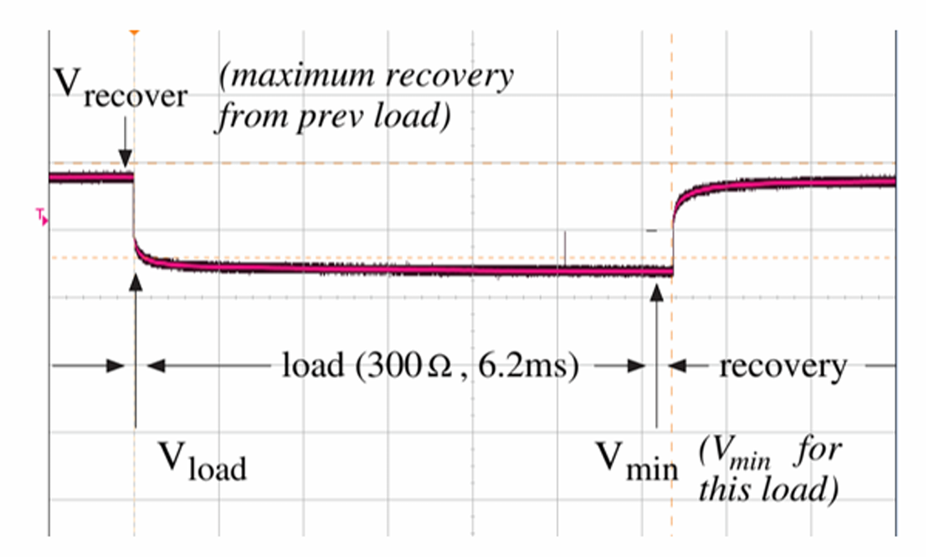
Batteries do not output constant voltage...
Duracell OP1500 AA battery
UGent IOT course - Jeroen Hoebeke & Eli De Poorter
79

Slide 80
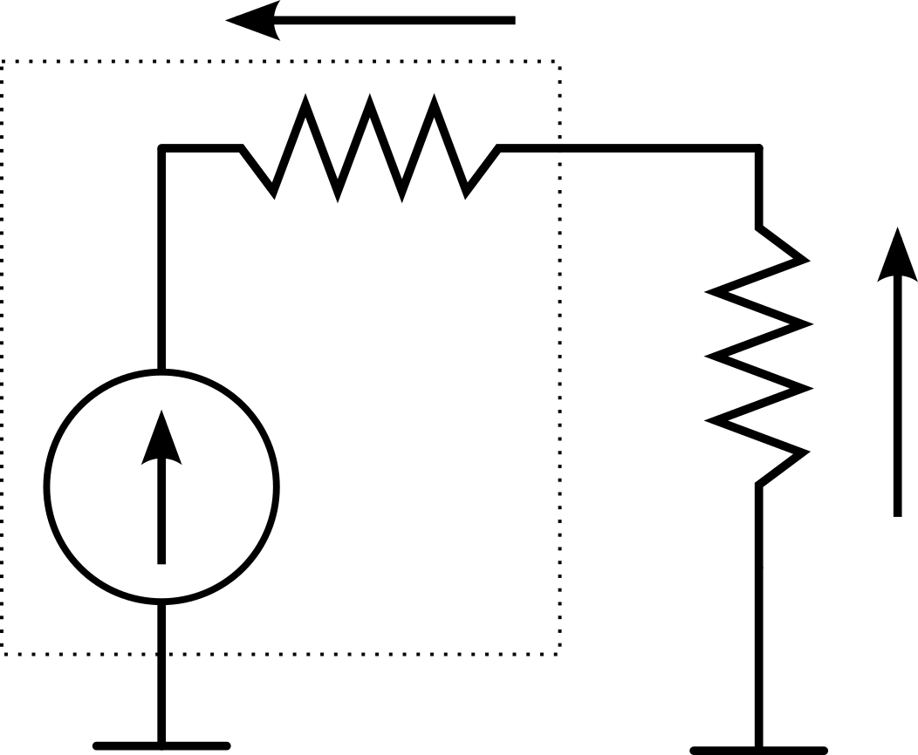
Batteries do not output constant voltage due to internal resistance
V_{Rin}
V_{load}
UGent IOT course - Jeroen Hoebeke & Eli De Poorter
80

Slide 81
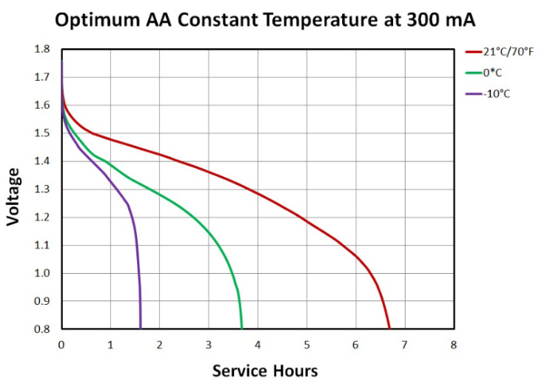
Battery performance improves with higher temperature...
Duracell OP1500 AA battery
81

Slide 82
Battery performance improves with higher temperature, but lifetime decreases
Capacity
Internal resistance
Temperature
Chemical reactions
Self-discharge
Risk of leakage
Lifetime
82
Notes:
Reduced Capacity: At low temperatures, the chemical reactions inside an alkaline battery slow down. This reduction in reaction rate leads to decreased capacity, meaning the battery delivers less power and may appear to be "dead" even if it still has charge left.
Increased Internal Resistance: The internal resistance of the battery increases as the temperature drops, which reduces the amount of current the battery can supply. This can lead to devices not working properly or shutting down.
Voltage Drop: The voltage output of the battery can drop significantly in cold conditions, which may cause devices to fail to operate or to function improperly.
Recovery: If a battery is used at low temperatures and then brought back to room temperature, its performance may recover, and it may deliver more power as the chemical reactions speed up again.
Increased Self-Discharge: At high temperatures, the rate of self-discharge increases. This means the battery will lose its charge more quickly even when not in use, reducing its overall shelf life.
Accelerated Chemical Reactions: While higher temperatures can initially improve performance by accelerating chemical reactions, this effect is usually short-lived and comes with drawbacks.
Risk of Leakage: Prolonged exposure to high temperatures can cause the electrolyte to expand, leading to an increased risk of leakage. Leakage not only damages the battery but can also harm the device in which the battery is used.
Shortened Lifespan: High temperatures accelerate the degradation of the battery's internal components, leading to a shorter overall lifespan. Repeated exposure to high temperatures can permanently reduce the battery's capacity and efficiency.
Potential for Explosion: In extreme cases, very high temperatures can cause the battery to overheat and, in rare cases, explode, though this is more common in rechargeable batteries than in standard alkaline batteries.

Slide 83
Supercapacitors are suited for fast charging and short high-power bursts
Stores charge in electric field
https://www.nde-ed.org/Physics/Electricity/capacitance.xhtml
83

Slide 84
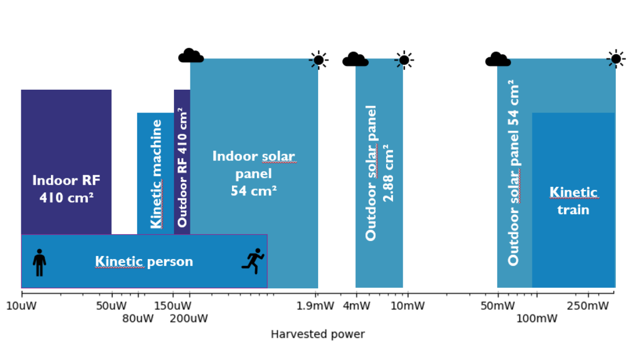
Supercapacitors are used with energy harvesting
UGent IOT course - Jeroen Hoebeke & Eli De Poorter
84
Notes:
Highlight solar panels, kinetic person, RF
Mention philips light switch "the movement of the light switch to generate a small burst of energy, resulting in sufficient energy to transmit a few packets to a lightbulb or a central receiver."

Slide 85
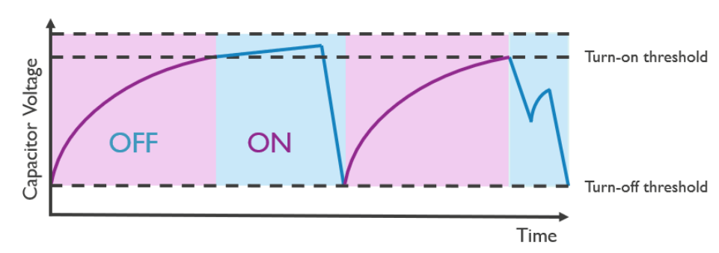
Energy harvesting requires advanced scheduling
Data transmission
UGent IOT course - Jeroen Hoebeke & Eli De Poorter
85

Slide 86
Batteries | Supercapacitors
Prolonged continuous power | Short bursts of high power
Finite lifespan due to electrochemical reactions | Longer lifespan
Sensitive to temperature | More stable in extreme environments
Slow charging | Fast charging
Smaller form factors | Typically more bulky
Cheaper | More expensive
Straightforward energy harvesting | Energy harvesting with advanced scheduling
86

Slide 87
THINGS
Sensors

Slide 88
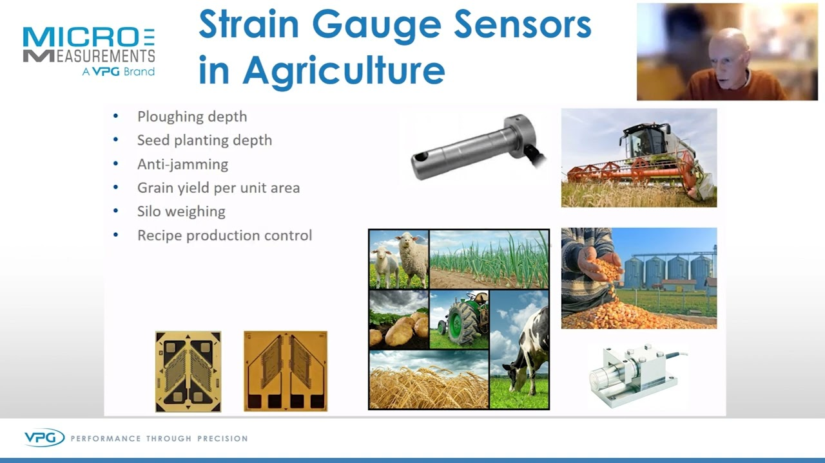
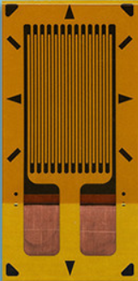
A sensing element has characteristics changing under environment influence
88

Slide 89

V =RI
89
Notes:
How about someone else tells me what a resistor is

Slide 90

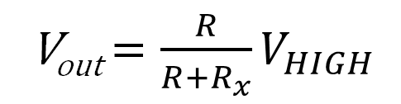
Sensing element needs transduction
V_{HIGH}
Variable sensor resistance R_{x}
V_{out} = $\frac{R}{R+R_{x}}V_{HIGH}$
Pull-down resistor R
(voltage divider formula)
90

Slide 91
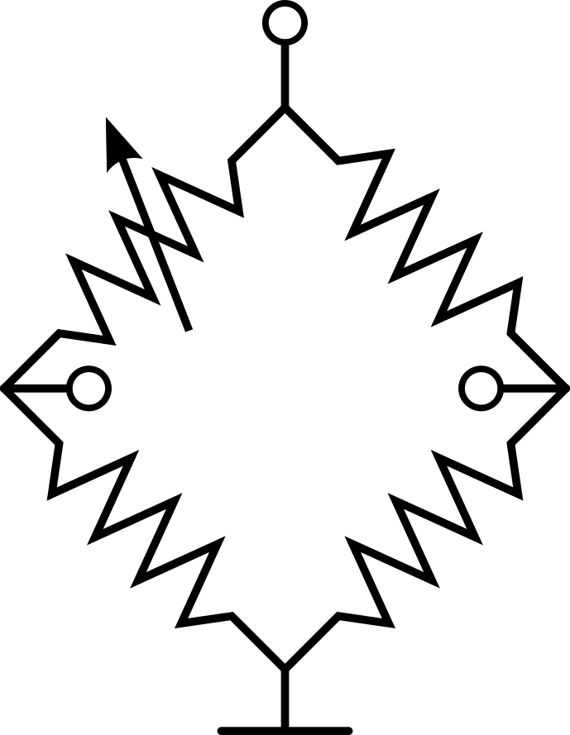
Sensing element needs transduction
V_{HIGH}
Variable sensor resistance R_{x}
Wheatstone bridge for higher sensitivity and zero DC offset
V_{out}
91
Notes:
Wheatstone bridge has noise reduction properties (subtractive measurement), and output is easily amplified because zero DC offset

Slide 92
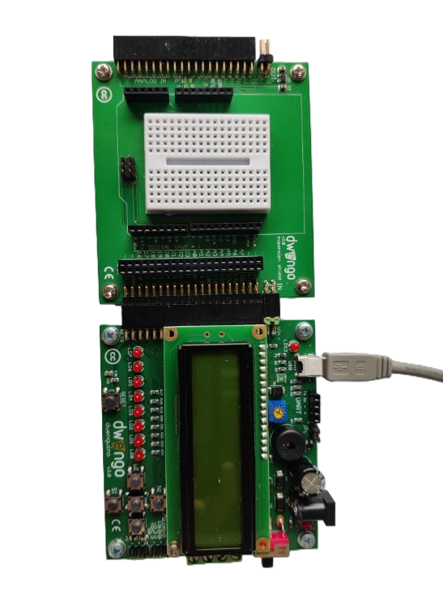
We'll be working with the Dwenguino microcontroller
PRACTICAL
Dwengo vzw, Francis wyffels
92
Notes:
Dwenguino is made by a non-profit founded by my PhD supervisor, professor Francis wyffels

Slide 93
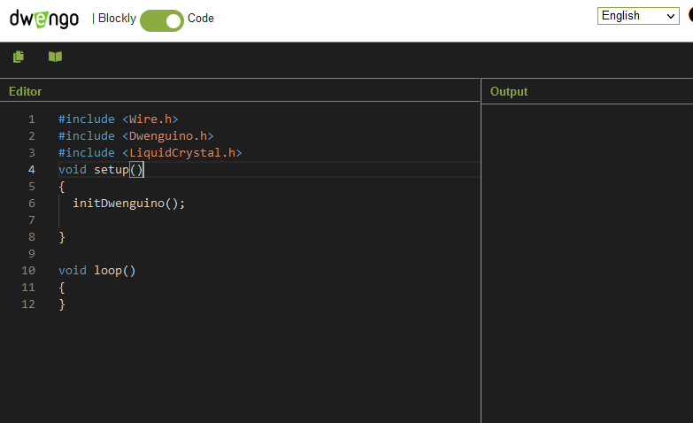
We compile Dwenguino code in the browser
https://blockly.dwengo.org/?lang=en
PRACTICAL
93
Notes:
Show live Blink example

Slide 94
Flashing the Dwenguino
Press and hold RESET
Press and hold DOWN
Release RESET
Release DOWN
The Dwenguino should present as a USB drive to your device. Paste the downloaded file onto the drive.
PRACTICAL
RESET
DOWN
94

Slide 95
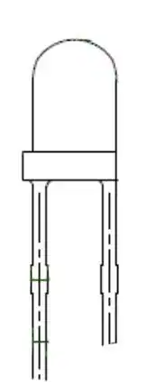

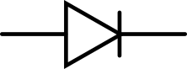
First circuit: photodiode
5V
-
"Reverse bias"
PRACTICAL
+
A6
+
-
+
-
GND
95

Slide 96
NEVER
"HOT SWAP"
PRACTICAL
96

Slide 97
First circuit: photodiode
5V
-
PRACTICAL
+
A6
GND
97

Slide 98
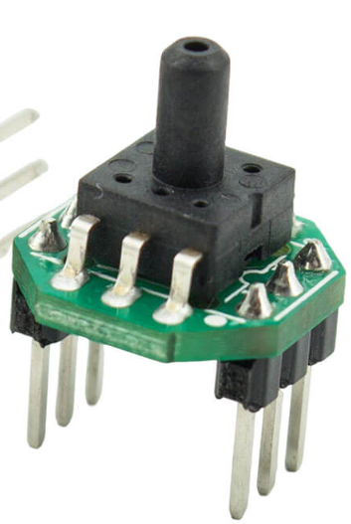
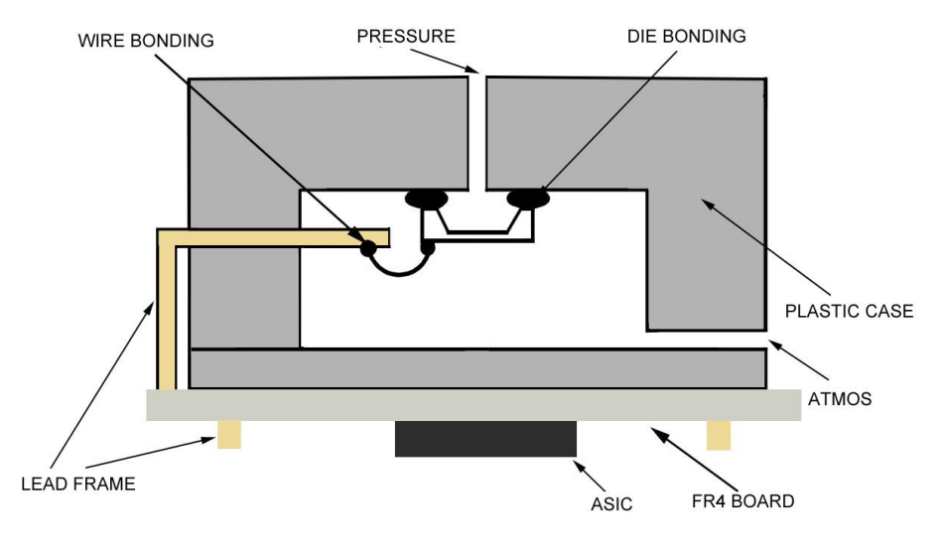
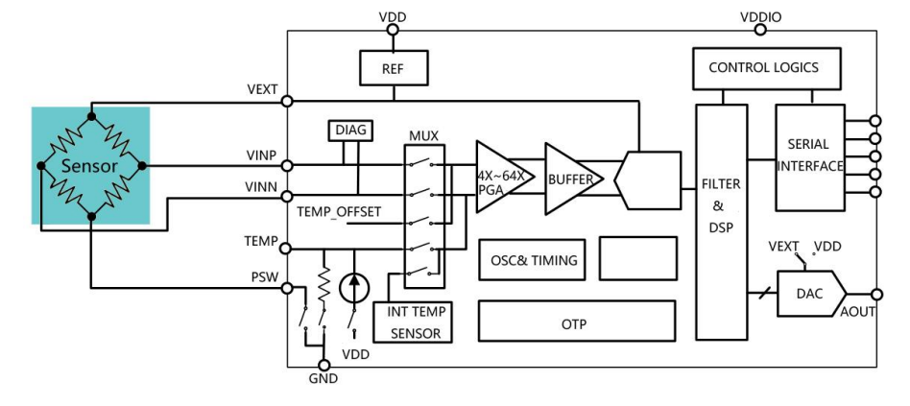
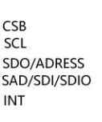
XGZP6847A
98
Notes:
Wheatstone bridge has noise reduction properties (subtractive measurement), and output is easily amplified because zero DC offset

Slide 99
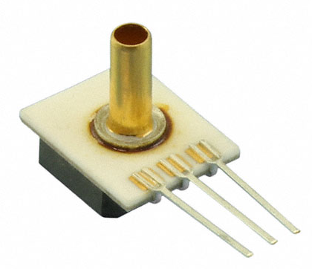

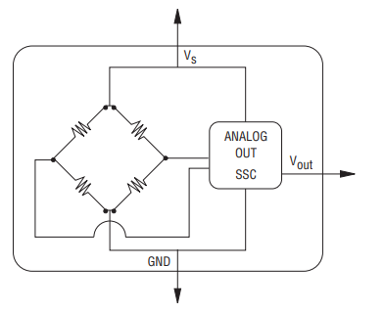
Integrating transduction turns sensing element into analog sensor
Strain gauges
BPS130
Diaphragm
Pressure
99
Notes:
Wheatstone bridge has noise reduction properties (subtractive measurement), and output is easily amplified because zero DC offset

Slide 100
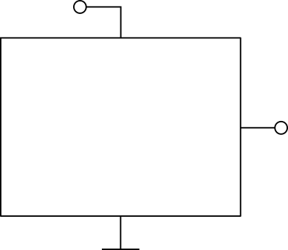

Analog sensor can be read by an ADC
V_{DD}
Analog sensor
Digital
interface
ADC
V_{out}
V_{in}
BPS130
100

Slide 101

Analog signal may require anti-aliasing filter
V_{DD}
Analog sensor
LP filter
F_{c}=F_{s}/2
ADC
101

Slide 102

Analog signal may need to be attenuated
5V
3,3V
Analog sensor
ADC
Voltage divider and buffer
102

Slide 103

Analog signal may be amplified
3,3V
5V
Analog sensor
ADC
Amplifier with gain 5V/3V=1,67
103

Slide 104

Integrating ADC turns analog sensor digital
ADC
XGZP6847A
104
Notes:
Wheatstone bridge has noise reduction properties (subtractive measurement), and output is easily amplified because zero DC offset

Slide 105

Digital sensors communicate via protocols: I²C
V_{DD}
SDA
Digital sensors
I²C master
SCL
XGZP6847A
105
Notes:
Note how wired, digital communication here doesn't use modulation, for wireless it HAS to be used (otherwise all that remains is ASK, no multiplexing techniques). Here, the communication channel is dedicated and controlled enough, to where a bit can be transmitted as a logical HIGH. IC communication like this is link-layer

Slide 106


I²C pull-up resistors should be as large as possible while maintaining signal integrity
SDA or SCL
V_{DD}
Parasitic capacitance
Increasing RC
106

Slide 107

I²C pull-up resistors should be as large as possible while maintaining signal integrity
SDA or SCL
V_{DD}
Parasitic capacitance
107

Slide 108

I²C may require level shifting
3,3V
5V
I²C
level shifter
Digital sensors
I²C master
108

Slide 109

Digital sensors communicate via protocols: SPI
V_{DD}
CS1, 2, 3...
MOSI
SPI master
Digital sensors
MISO
SCLK
109
Notes:
More wires but less protocol overhead -> faster communication possible

Slide 110

SPI may require level shifting
3,3V
5V
SPI
level shifter
Digital sensors
SPI master
110

Slide 111
Digital sensors communicate via protocols: UART
V_{DD}
RX
RX
Device 1
Device 2
TX
TX
111
Notes:
More wires but less protocol overhead -> faster communication possible

Slide 112
Choose protocol based on project requirements
I²C | SPI | UART
2 communication wires | 4 communication wires | 2 communication wires
Slave selected by address transmission (protocol overhead) | Slave selected by dedicated CS line (hardware complexity) | Can only connect two devices
Requires pull-up resistors | No pull-up resistors | No pull-up resistors
standard mode 100 kbit/s fast mode 400 kbit/s fast mode plus 1 Mbit/s high-speed mode 3.4 Mbit/s | > 10 Mbit possible | Fixed set of bitrates: 9600, 19200, 38400, 57600, 115200, 230400, 460800, 921600, 1000000, 1500000
Half-duplex | Full-duplex | Full-duplex
Data transferred in bytes | Arbitrary data length | Data length is 5-9 bits
Synchronous (SCL) | Synchronous (SCK) | Asynchronous (both devices must fix same bitrate)
112
Notes:
Get two people up front to act out the protocols
Humans are half-duplex

Slide 113
Digital sensor
Analog sensor
Sensor element
Transduction mechanism
+
Protocol
interface
ADC
+
Consider level shifting,
pull-up dimensioning, …
+
Amplification?
Attenuation?
113

Slide 114
Microcontrollers and Microprocessors...
...both integrate a CPU, that can execute a fixed set of commands, synchronised by a clock, but:
114
Notes:
Mention existing of real-time operating system, make clear that the divide is getting more and more vague, some MPU's include memory and GPU for example

Slide 115
Microcontrollers and Microprocessors...
...both integrate a CPU, that can execute a fixed set of commands, synchronised by a clock, but:
Microcontrollers | Microprocessors
Combines CPU, memory, and peripheral interfaces on a single chip | Usually includes only CPU and relies on external components for memory and peripherals
Specific purposes, like sensor readout and actuator control | General-purpose, like a computer
Typically no operating system | Typically uses operating system
Appropriate for real-time applications where exact timing is necessary | If operating system is used, real-time operation cannot be guaranteed
Less computing power | More computing power
Less power usage | More power usage
… | …
115
Notes:
Mention existing of real-time operating system, make clear that the divide is getting more and more vague, some MPU's include memory and GPU for example

Slide 116









Microcontrollers and Microprocessors
116
Notes:
Particle: complete IoT ecosystem with cloud services
Raspberry pi by far largest community and hence best documentation
NVidia Jetson end of life

Slide 117



More sensors!
PRACTICAL
5V
SCL
GND
BLACK wire:
RED wire:
BLUE wire:
GND
5V
Analog output voltage
SDA
Remember pull-ups SDA->5V and SCL-> 5V
117
Notes:
Read multiple sensors, turn on LED based on sensor threshold
1hr

Slide 118
THINGS
Actuators

Slide 119
Sensing element: changing characteristics under environment influence
Actuator: influences environment
119
Notes:
Segway: input gezien, outputs in mindere zin (LEDs), nu actuators

Slide 120
Actuators
Electrical actuators
Hydraulic actuators
Pneumatic actuators
Thermal actuators
Optical actuators
Mechanical actuators

Slide 121


Actuators
Electrical actuators
DC (servo)motors
AC (servo)motors
Stepper motor
Solenoids
121

Slide 122

DC motors convert electrical current into rotational motion
https://www.linquip.com/blog/working-principle-of-dc-motor/
122
Notes:
Note: brushed DC motor
LEFT HAND FBI RULE APPLIES, NOT RIGHT HAND. RIGHT HAND IS FOR INDUCED CURRENT

Slide 123

DC motors convert electrical current into rotational motion
https://www.electricaleasy.com/2014/01/basic-working-of-dc-motor.html
123
Notes:
Note: brushed DC motor

Slide 124
Servomotor =
motor with internal feedback
124

Slide 125

Small servomotors are accessible actuators for simple designs
Tower Pro micro servo 9g
https://www.makerguides.com/servo-arduino-tutorial/
125

Slide 126

Small servomotors are typically controlled via Pulse Width Modulation (PWM)
https://acroname.com/articles/description-pulse-width-modulation
126
Notes:
PWM is what an analogWrite does on µCs
Emphasize that any microcontroller will have PWM output

Slide 127

High-end servomotors may require specific hardware
https://emanual.robotis.com/docs/en/parts/interface/mkr_shield/
127

Slide 128


Stepper motors are robust alternatives for low to moderate precision
RS Pro 535-0401
https://electricdiylab.com/how-stepper-motor-works/
128
Notes:
Discrete rotation as opposed to continuous DC motor
Stepper Motors:
Commonly used in 3D printers, CNC machines (for low to moderate precision tasks), simple robotics, and other applications where precise but not highly dynamic motion is needed.
Ideal for applications where the load is consistent and predictable.
Servomotors:
Used in high-performance CNC machines, robotics (where high precision and dynamic response are required), industrial automation, camera stabilization systems, and aerospace applications.
Suitable for tasks requiring rapid changes in motion, high speed, and precise control under varying loads.

Slide 129

Stepper motors need additional hardware
+
+
Tb6560 stepper driver
RS Pro 535-0401
129

Slide 130

Solenoids achieve linear motion
https://www.smlease.com/entries/automation/what-is-solenoid-valve-and-how-does-solenoid-valves-work/
130

Slide 131

THINGS
Power management
Sensors
Actuators
Digital sensor
Analog sensor
Sensor element
Notes:
Sensors: also indicated difference between communication protocols, and µC vs µP

Slide 132
Reflection in groups, what IoT project do you want to make/do
132
Notes:
We’ve talked about the different types of sensors you can find and how a digital sensor is an integration of an analog sensor with adc and communication protocol interface, an analog sensor is an integration of a sensing element and a transduction mechanism to turn the changing characteristics of the sensing element into a readable voltage.
We’ve talked about the difference between µC and µP, and you now have first-hand experience with programming a microcontroller and reading sensors.

Slide 133
Introduction to IoT
ir. Remko Proesmans
AI and Robotics Lab – Ghent University – imec
Notes:
I’ve been told we have quite a diverse audience here today, I will highlight some concepts which I think are important when putting theory into practice withouth going into too much detail. Now, that means I maybe won’t give enough detail for you to understand the bigger picture

